Slide 1


Two Stage Multi-Document Summarization with BERT CS 886 – Final Project - Presentation
Presenter: Archit Shah (20773927)

Slide 2
Summarization Task in NLP
Single Document Summarization
Creating a fluent and accurate summary from a given text document
One summary per text document
Quite a popular task in NLP, many datasets and models available to work with
Multi-Document Summarization
Capture the information in multiple documents that are related thematically and deduce information in a single summary
Documents are grouped by themes/topics/categories/news events and one summary per group is generated
More complicated than single document summarization
Not as popular as single document task, limited models and datasets available

Slide 3
Related Work so far
Up until recently, multi-document summarization models did not achieve great results.
With advent of Transformer architecture, there has been a renewed interest.
In 2018, Peter J. Liu et al (2018) proposed Transformer decoder with memory compression Attention, which achieved ROUGE-1 F1 score of 43, and a new dataset called WikiSum.
In 2019, Fabbri et al. (2019) proposed another dataset called Multi-News for this task. The authors achieved a Rouge F1 score of 43 on this dataset with a Pointer Generator network inspired Transformer.

Slide 4
Dataset
Multi-News dataset by Fabbri et al (2019)
Multiple articles for same news event form our document group
45,000 news events and 125,000 individual news articles
The dataset provides hand-written summaries for all 45,000 news events
The news summaries have an average length of 260 words, which is quite long and that could be a downside to this dataset

Slide 5
Model
A modified BERT model, that can generate abstractive summary from a given text.
Encoder: A pre-trained Bert Architecture for summarization (BERTSUM) by Liu et al. (2019)
Decoder: Six layered Transformer
Model is fine-tuned on CNN/DailyMail dataset in two steps. Encoder is fine-tuned on extractive summarization task and decoder is fine-tuned on abstractive summarization task.
This fine-tuning is claimed to have boost the abstractive summarization task by many papers
This fine-tuned model for single document summarization will be applied for our 2-staged multi-document summarization

Slide 6


Experiment
Raw Data
STAGE 1 SUMMARIES
STAGE 2 SUMMARIES
Document Group 1
Document Group 2
.
.
.
.
.
.
Document Group n

Slide 7
Experiment Setup
We use Google Cloud Platform to conduct this experiment
A computing instance (VM) is created with 2vCPUs, 13 GB memory and 100 GB disk
We attach 1 Nvidia Tesla P100 GPU with this instance in the cloud
We install all the necessary libraries like PyTorch and PyRouge to run our experiment
We clone the Git repository from Liu et al. (2019) for the model called BertSumExtAbs in the paper, and add our custom scripts for two-stage multi document summarization
At stage 1, we summarize individual news articles, about 125,000 documents and generate one summary per document, which took 70 hours. We then concatenate these summaries for further summarization on stage 2.
For stage 2, we further summarize the results from stage 1 and obtain 1 summary per news event, which took 10 hours. This means, about 45,000 summaries.

Slide 8
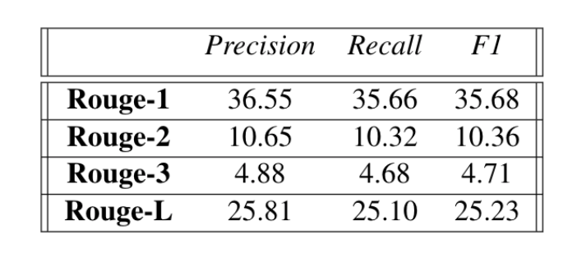
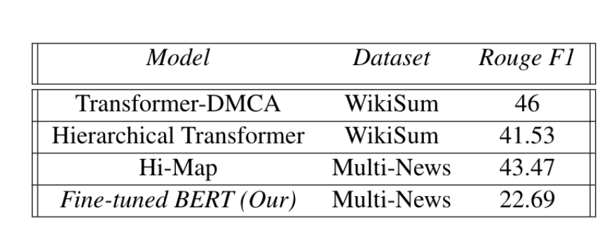
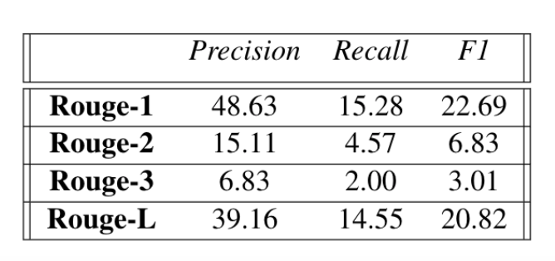
Quantitative Results
STAGE 1
Comparison with Existing Models
STAGE 2

Slide 9
Discussion
Clearly our model has performed quite poorly as compared to other existing models
Our model’s Recall has been specifically quite low as compared to other models
The reason for this is target golden summaries have an average length of about 260 words, while our model generated summaries are between 30-40 words. Recall captures percentage of words from golden summary that are also present in our model generated summary.
Another reason is the nature of task is abstractive – meaning the model intends to re-write the original text. Given this task, calculating overlapping words for Rouge evaluation, is somewhat contradictory to the task at hand.
Our model can be further optimized by training on Multi-News dataset instead of CNN/Dailymail for this task. But then it cannot be a pre-trained model and that might not be feasible for everyone.
It can also be improved by decreasing the penalty for sentence length. This however carries the risk of poor precision.

Slide 10
Qualitative Result

Slide 11
Original Text
warczone is a collection of outsider-uploaded warcs , which are contributed to the internet archive but may or may not be ingested into the wayback machine . they are being kept in this location for reference and clarity for the wayback team , while also being accessible to the general public who are seeking any particular items they can regarding certain websites . story_separator_special_tag november 21 , 2016 an open letter to local and state educational agencies &amp; policymakers : on behalf of the national women ’ s law center and the undersigned organizations and individuals , we call on local , state , and federal policymakers to address the damaging use of corporal punishment against our nation ’ s schoolchildren . it is important to eliminate the use of corporal punishment in both public schools and private schools , which serve students receiving federal services , as well as assist in creating a safer learning environment for every child . instead , we urge policymakers to ensure that our schools are places where students and educators interact in positive ways that foster students ’ growth and dignity . more than 109,000 students were subjected to corporal punishment in public schools in the 2013-14 school year — down from story_separator_special_tag buffalo , n.y. -- education secretary john b. king jr. is urging governors and school leaders in states that allow student paddling to end a practice he said would be considered “criminal assault or battery ” against an adult . king released a letter tuesday asking leaders to replace corporal punishment with less punitive , more supportive disciplinary practices that he said work better against bad behavior . more than 110,000 students , including disproportionate numbers of black and disabled students , were subjected to paddling or a similar punishment in the 2013-14 school year , said king , citing the education department ’ s civil rights data collection . corporal punishment is legal in 22 states . “the practice has been clearly and repeatedly linked to negative health and academic outcomes for students , ” king said during a conference call with reporters . story_separator_special_tag education secretary john king speaks during the daily briefing at the white house in washington , thursday , sept. 29 , 2016 . ( ap photo/susan walsh ) ( photo : susan walsh , ap ) u.s. education secretary john king is urging school districts nationwide to stop hitting and paddling students , saying corporal punishment is “harmful , ineffective , and often disproportionately applied to students of color and students with disabilities. ” in a “dear colleague ” letter being issued tuesday , king asks educators to “eliminate this practice from your schools , and instead promote supportive , effective disciplinary measures . “the use of corporal punishment can hinder the creation of a positive school climate by focusing on punitive measures to address student misbehavior rather than positive behavioral interventions and supports , ” king writes . “corporal punishment also teaches students that
Golden Summary
education secretary john king has a message for states where physical discipline is permitted in schools , per usa today : quit it . in a letter to governors and state school chiefs , king says 22 states — mostly in the south and west — still allow corporal punishment or don ' t forbid it . he implores them to stop the " harmful " and " ineffective " practice , saying it teaches kids that getting physical is ok to solve problems . he also points out that some corporal punishment taking place in schools would be considered criminal assault or battery in real-world settings . about 80 groups — including the naacp — lent their support to a similar letter penned monday by the national women ' s law center , reports cbs news . " corporal punishment of adults has been banned in prisons and in military training facilities , and it ' s time we do the same for our nation ' s schoolchildren , " an nwlc rep says . king also notes that physical punishment isn ' t applied equitably to all students . for example , even though black students make up about 16 % of attendees in public elementary and secondary schools , they ' re on the receiving end of one-third of the corporal punishment . boys are subjected to 80 % of such acts , while students with disabilities also tend to be victims more so than other students . " these data and disparities shock the conscience , " king writes . ( alabama paddled 19k students in one school year. )
Model Generated Summary
more than 109,000 students were subjected to corporal punishment in public schools in the 2013-14 year education secretary john b. king jr. is urging schools nationwide to stop paddling<q>king is urging governors and school leaders in states that allow student paddling to end a practice he said would be considered-criminal assault or battery against an adult

